Slide 1
Combinational Logic Design
Boxi Wu / Xiaofei He
Zhejiang University

Slide 2
Overview
Introduction to Verilog HDL
About combinational logic circuits
Some classic/basic designs
Timing analysis

Slide 3
Overview
Introduction to Verilog HDL
About combinational logic circuits
Some classic/basic designs
Timing analysis

Slide 4
Introduction to Verilog HDL
Background
HDL-based design flow
Verilog HDL

Slide 5
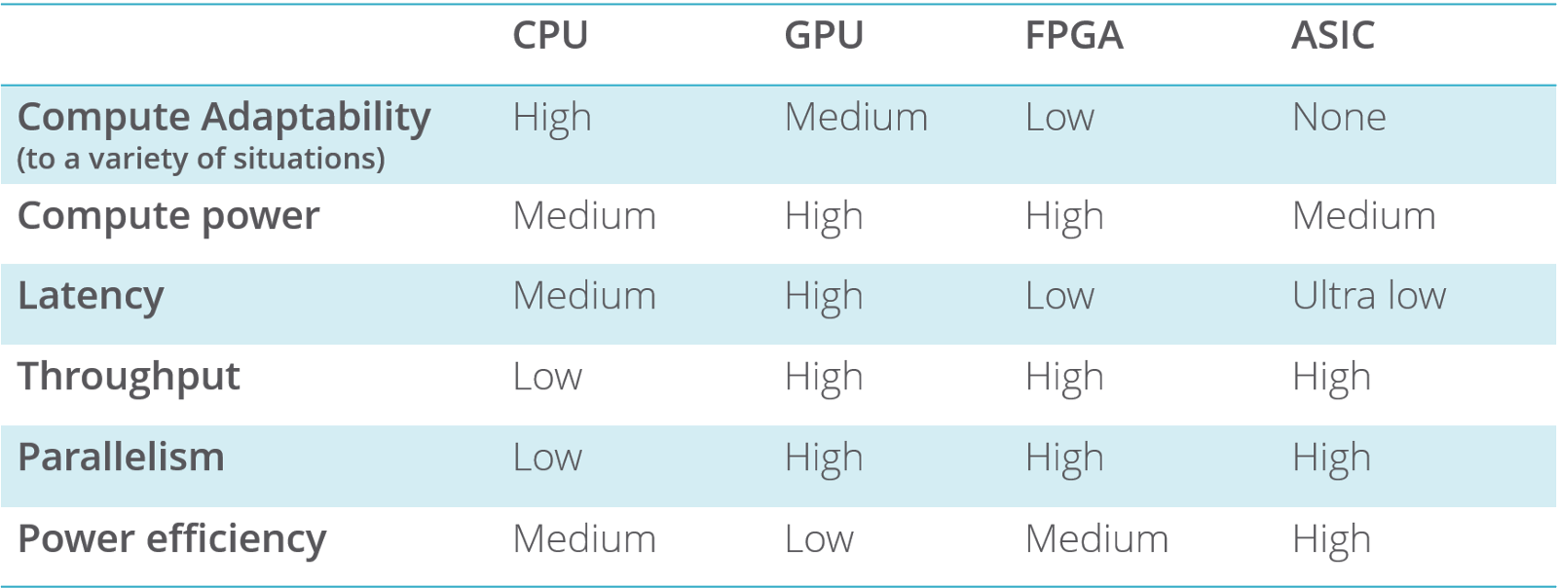
Background
Heterogeneous computing
  CPU vs. GPU vs. FPGA vs. ASIC
Digital circuit design
  FPGA vs. ASIC
Notes:
ASIC: Application-Specific Integrated Circuit，专用集成电路
FPGA：Field Programmable Gate Array，现场可编程门阵列
对常用的处理器芯片进行分类，有一个明显的特点：CPU&GPU需要软件支持，而FPGA&ASIC则是软硬件一体的架构，软件就是硬件。这个特点是处理器芯片中最重要的一个特征。
从ASIC->CPU的方向，沿着这个方向芯片的易用性越来越强: CPU&GPU的编程需要编译系统的支持，编译系统的作用是把高级软件语言翻译成机器可以识别的指令。高级语言带来了极大的便利性和易用性，因此用CPU&GPU实现同等功能的软件开发周期要远低于FPGA&ASIC芯片。
沿着CPU->ASIC的方向，芯片中晶体管的效率越来越高: 因为FPGA&ASIC等芯片实现的算法直接用晶体管门电路实现，比起指令系统，算法直接建筑在物理结构之上，没有中间层次，因此晶体管的效率最高。
本质上软件的操作对象是指令，而CPU&GPU则扮演高速执行指令的角色。指令的存在将程序执行变成了软件和硬件两部分，指令的存在也决定了各种处理器芯片的一些完全不同的特点以及各自的优劣势。
FPGA&ASIC等芯片的功能是固定的，它们实现的算法直接用门电路实现，因此FPGA&ASIC编程就是用门电路实现算法的过程，软件完成意味着门电路的组织形式已经确定了，从这个意义上，FPGA&ASIC的软件就是硬件，软件就决定了硬件的组织形式。软硬件一体化的特点决定了FPGA&ASIC设计中极端重要的资源利用率特征。利用率指用门电路实现算法的过程中，算法对处理器芯片所拥有的门电路资源的占用情况。如果算法比较庞大，可能出现门电路资源不够用或者虽然电路资源够用，但实际布线困难无法进行的情况。
FPGA: 小批量产品设计占优势，灵活、速度慢、资源冗余、价格昂贵
ASIC: 设计成本高周期长，面向特定用户需求，批量大的专用产品占优势，体积小、功耗低、可靠性高、保密性强、成本低

Slide 6
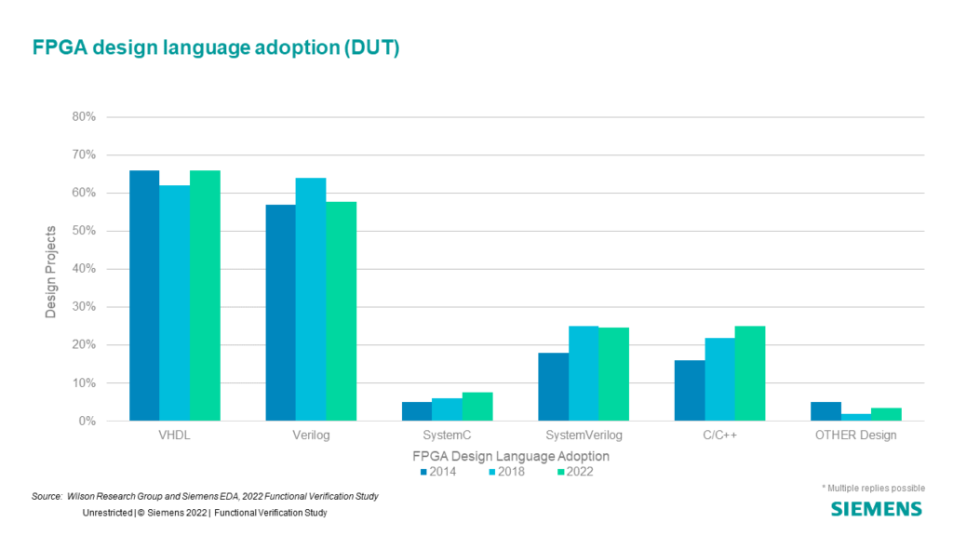
What is HDL?
Hardware description language is a language that uses formal methods to describe digital circuits and design digital logic systems.
Notes:
VHSIC: Very High Speed Integrated Circuit
VHDL: VHSIC Hardware Description Language
VHDL 优势：语法检查严格，库封装库，结构，模块化功能比verilog更全面。
劣势：语法要求严格，冗余代码较多（各种数据类型转换，库包含，一开始就晕了）。
Verilog 优势：语法简单，关键字少，开发快速
劣势: 语法检查松懈，很多问题隐藏在警告当中，不能对数据结构进行封装。
SystemVerilog 优势：能够实现各种结构，接口，层次，封装模块化各个功能，熟悉后，开发，仿真都会很便捷。
劣势：类似c和c++的区别，功能越多，越难掌握

Slide 7
HDL-based Design Flow
Logic design with HDL
Simulation
Synthesis
Physical Design
Final step

Slide 8
Logic design with HDL
Define a module
  module top( Module definition start
  input a, Port definition
  input b,
  output c
  );
  assign c = a &b; Assignment statement
  endmodule Module definition end

Slide 9
Simulation
Testbench
  module sim_top();
  reg a_in,b_in;
  wire c_out;
  top dut(
  .a(a_in),
  .b(b_in),
  .c(c_out)
  );
  initial begin
  a_in = 1’b0;
  b_in = 1’b0;
  #2
  b_in = 1’b1;
  #2
  a_in = 1’b1;
  #2
  $finish;
  end
  always @(*)begin
  $display(“a=%d,b=%d,c=%d, a_in,b_in,c_out);
  endmodule
Notes:
通过软件模拟数字逻辑电路
测试激励
模块级验证，系统级验证

Slide 10
Synthesis
Parsing
Multi-level synthesis
  Non-synthesizable HDL code
Technology mapping
Notes:
代码解析
多级综合
仿真相关的不可综合代码被忽略，如果设计相关的不可综合代码（如组合逻辑电路中包含回路）则报错
工艺映射：将电路描述进一步转换成特定工艺的标准单元，输出网表；标准单元是工艺相关的，由晶圆厂商以提供标准单元库的方式提供；综合工具在这一阶段需要读取标准单元库的信息，然后与多级综合的结果进行模式匹配，完成标准单元的映射；标准单元最后会参与电路的生产环节，并在实体上以晶体管的形式存在于产出的电路芯片中。

Slide 11
Physical Design
Placement
Routing
Static timing analysis
LVS and DRC
Generating result
  ASIC: layout file
  FPGA: bitstream file
Notes:
布局：确定每个标准单元在三维空间的位置
布线：根据netlist中描述的标准单元的连接关系，在三维空间中通过物理走线将相应的标准单元连接起来
静态时序分析：根据标准单元和走线的延时信息，分析布局布线结果，报告电路能运行的最大频率和每条路径的延时情况，其中关键路径是瓶颈，设计者可根据关键路径的信息对设计做优化。
电路和规则检查：主要包括版图和原理图的一致性检查（Layout Versus Schematics， LVS），以及设计规则的检查（Design Rule Check, DRC）；DRC主要做物理检查，比如两根线是否距离太近可能发生短路等。
生成物理设计结果：ASIC生成版图文件；FPGA则生成bitstream文件。

Slide 12
Final Step
ASIC
  Tape-out
FPGA
  Download bitstream file
Notes:
ASIC: 流片，晶圆厂商根据版图文件生产相应的电路芯
FPGA: 将bitstream文件下载到fpga设备，可已将fpga配置为目标电路的逻辑，可开展系统级的验证工作

Slide 13
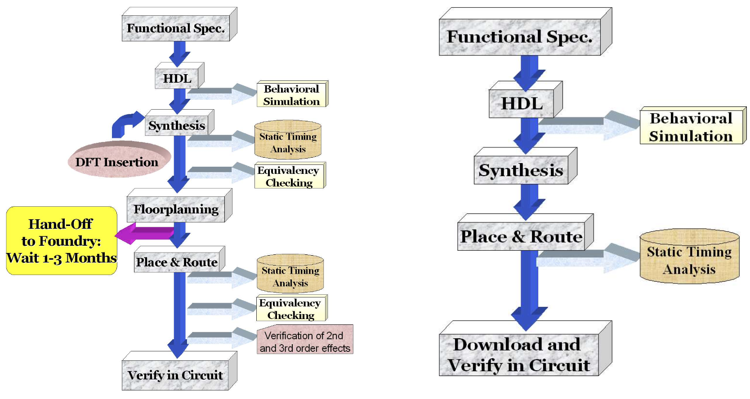
Design Flow: ASIC vs. FPGA
https://www.xilinx.com/video/fpga/fpga-vs-asic-design-flow.html

Slide 14
Verilog HDL
Lexical conventions
Basic syntax
Modeling methods

Slide 15
Lexical Conventions
Very similar to C
  Verilog is case-sensitive
  All keywords are in lowercase
A Verilog program is a string of tokens
  Whitespace
  Comments
  Delimiters
  Numbers
  Strings
  Identifiers
  Keywords

Slide 16
Lexical Conventions (cont’d)
Whitespace
  Blank space (\b)
  Tab (\t)
  Newline (\n)
Whitespace is ignored in Verilog except
  In strings
  When separating tokens
Comments
  Used for readability and documentation
  Just like C:
    // single line comment
    /* multi-line
    comment
    */
/* Nested comments
/* like this */ may not be acceptable (depends on Verilog compiler) */

Slide 17
Lexical Conventions (cont’d)
Number Specification
  Sized numbers
  Unsized numbers
  Unknown and high-impedance values
  Negative numbers

Slide 18
Lexical Conventions (cont’d)
Sized numbers
  General syntax: <size>’<base><number>
    <size> number of bits (in decimal)
    <number> is the number in radix <base>
    <base> :
      d or D for decimal (radix 10)
      b or B for binary (radix 2)
      o or O for octal (radix 8)
      h or H for hexadecimal (radix 16)
    Examples:
      4’b1111
      12’habc
      16’d255
Unsized numbers
  Default base is decimal
  Default size is at least 32 (depends on Verilog compiler)
  Examples
    23232
    ’habc
    ’o234

Slide 19
Lexical Conventions (cont’d)
X or Z values
  Unknown value: lowercase x
    4 bits in hex, 3 bits in octal, 1 bit in binary
  High-impedance value: lowercase z
    4 bits in hex, 3 bits in octal, 1 bit in binary
  Examples
    12’h13x, 6’hx, 32’bz
  Extending the most-significant part
    Applied when <size> is bigger than the specified value
      Filled with x if the specified MSB is x
      Filled with z if the specified MSB is z
      Zero-extended otherwise
    Examples:
      6’hx
Notes:
为了移植性，不建议适用不定态和高阻态。

Slide 20
Lexical Conventions (cont’d)
Negative numbers
  Put the sign before the <size>
  Examples:
    -6’d3
    4’d-2 // illegal
  Two’s complement is used to store the value
Underscore character and question marks
  Use ‘_’ to improve readability
    12’b1111_0000_1010
    Not allowed as the first character
  ‘?’ is the same as ‘z’ (only regarding numbers)
    4’b10?? // the same as 4’b10zz

Slide 21
Lexical Conventions (cont’d)
Strings
  As in C, use double-quotes
  Examples:
    “Hello world!”
    “a / b”
    “text\tcolumn1\bcolumn2\n”
Identifiers and keywords
  identifiers: alphanumeric characters, ‘_’, and ‘$’
    Should start with an alphabetic character or ‘_’
    Only system tasks can start with ‘$’
  Keywords: identifiers reserved by Verilog
  Examples:
    reg value;
    input clk;
Notes:
任何用verilog语言描述的“对象”都用名字来识别，即标识符，如模块名、端口名等。
关键字都是小写字母组成

Slide 22
Lexical Conventions (cont’d)
Escaped identifiers
  Start with ‘\’
  End with whitespace (space, tab, newline)
  Can have any printable character between start and end
  The ‘\’ and whitespace are not part of the identifier
  Examples:
    \a+b-c // a+b-c is the identifier
    \**my_name** // **my_name** is the identifier
  Used as name of modules
Notes:
转义标识符： (escaped identifier )可以在一条标识符中包含任何可打印字符。转义标识符以\ (反斜线)符号开头，以空白结尾（空白可以是一个空格、一个制表字符或换行符）。
Verilog HDL allows any character to be used in an identifier by escaping the identifier. Escaped identifiers provide a means of including any of the printable ASCII characters in an identifier (the decimal values 33 through 126, or 21 through 7E in hexadecimal).

Slide 23
Basic Syntax: Module, Port and Instantiate
Module and port
module model-name (port list);
<Port definition> - optional
Data type definition
Logic function description
endmodule
Instantiate
model-name instance-identifier (port related list);
  module top(
  input a,
  input b,
  output c
  );
  assign c = a & b;
  endmodule
  module sim_top();
  reg a_in,b_in;
  wire c_out;
  top dut(
  .a(a_in),
  .b(b_in),
  .c(c_out)
  );
  initial begin
  a_in = 1’b0;
  b_in = 1’b0;
  #2
  b_in = 1’b1;
  #2
  a_in = 1’b1;
  #2
  $finish;
  end
  always @(*) begin
  $display(“a=%d,b=%d,c=%d, a_in,b_in,c_out);
  end
  endmodule
Notes:
sim_top是父模块，top是子模块，模块实例化建立了父模块的信号和子模块的端口之间的关联。
数字逻辑电路内部可视为若干元件和若干结点互连而成，每个结点时若干连线的汇集点，会给于同一结点的所有连线上传输的同一个信号。
元件和结点（或连线）时两类基本要素。元件可抽象为模块，而汇集于同一结点的物理连线则代表同一个信号，描述了多个元件或模块之间应该如何连接。因此，数字电路设计可归纳为：实例化元件或模块并用线将它们连接起来。

Slide 24
Basic Syntax: Data Type
Net
  Physical connection (wire type)
Register
  Storage element (reg type)
Vectors and Arrays
  Vector: multi-bit signal
    E.g., wire[7:0] a; reg[31:0] rdata, wdata;
  Array:
    E.g., wire b[2:0] or reg[15:0] mem [1023:0]
Parameter
  Local scope (the current module)
  Usually defined as constant
Notes:
网线类型：用于表示原件或模块之间的物理连接，可综合电路中，最常用的是wire，也是端口表达式声明的默认数据类型，其它类型大部分不可综合或很少使用；
寄存器类型：表示抽象的存储元件，可综合电路中最常用的是reg，其它很少使用；
向量和数组：允许多个一位信号组成整体操作，即向量；可构成数组，使用时只能单个元素引用，早期（2001之前？）不能引用内部比特位，之后可以。
参数类型：用于给常量赋予有意义的标识符，提高可读性，类似C语言的typdef

Slide 25
Basic Syntax: Data Type (cont’d)
Module’s port type
  Input
    Definition: wire
    Instantiate: wire or reg
  Output
    Definition: wire or reg
    Instantiate: wire
  module Right (
  input in1,
  input wire in2,
  input [3:0] in3,
  output out1,
  output [3:0] out2,
  output reg [1:0] out3
  );
  …
  endmodule
  module Wrong (
  input reg in1, output out1 [2:0]
  );
  …
  endmodule
Notes:
模块端口可定义为向量，不能为数组
允许关联信号的位宽于端口尾款不同，会有警告，需仔细检查并排除
允许端口保持未关联状态，可认为未关联的输出端口不被使用；但未关联的输入端口缺省值是高阻态，并非可综合电路的特性，一般综合器会用0作为缺省值，对于低电平有效的输入端口而言可能会导致非预期结果。

Slide 26
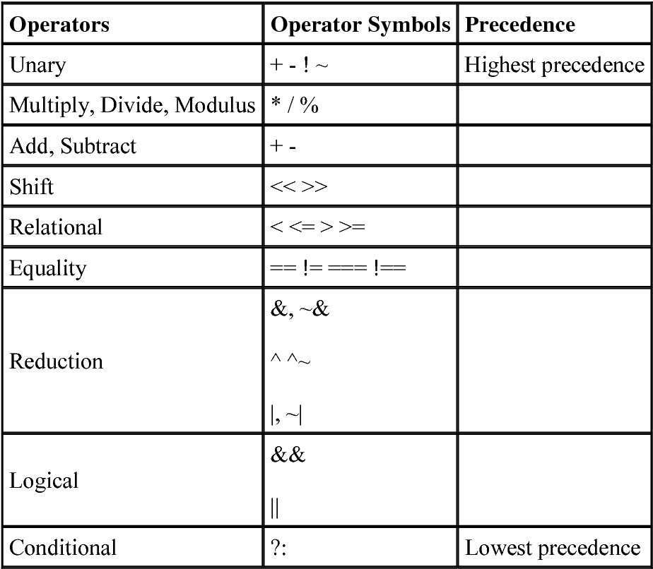
Basic Syntax: Operator and Precedence
Unary operators:
  + -
Bitwise operators
  ~ & | ^ ^~
Arithmetic operators
  + - * / %
Reduction operators
  & ~& | |~ ^ ^~
Logic operators
  && || !
Logic equality operators
  == !=
Relational operators
  < <= > >=
Bit Concatenation operators
  { }
Shift operators
  >> <<
Conditional operator
  ?:

Slide 27
Modeling methods
Structured modeling
  Module-level
  Gate-level
  Switch-level
Dataflow modeling
  Suitable for modeling combinational logic circuits
  Use continuous assignment statements: assign
Behavioral modeling
  Key elements: always
  always @(event signal list) procedure statement
Notes:
结构化建模：将电路描述程一个分级的子模块系统，并通过逐层调用子模块来构建复杂的系统，根据子模块不同的抽象级别，可分为三类
模块级结构化建模：通过调用用户设计的子模块对电路建模；
门级结构化建模：通过调用Verilog内建的基本门级元件（如或、与、非门）来对电路建模；
开关级结构化建模：通过调用Verilog内建的基本开关元件（如晶体管等）来对电路建模；
数据流建模：从数据的视角出发，通过描述数据在电路中的流动方向来描述电路的功能，可用于组合逻辑电路（大部分组合逻辑电路都是采用数据流建模方式描述），不适用于时序逻辑电路（因涉及数据的存储和更新）；主要通过连续赋值语句进行建模，需注意：
多个连续赋值语句之间是并行关系；
Verilog中未定义的信号缺省为位宽为1的wire类型，如果对一个未定义的变量赋值，则相当于对该wire类型变量进行驱动，若此时赋值号右边表达式结果为向量，则会发生位宽的截断，可能会造成行为与预期不符。
不能对相同的网线进行重复驱动。
所描述的电路不能出现组合回路。
3)和4)符合组合逻辑电路的要求。
行为建模：通过一系列以高级编程语言编写的过程块来描述数字系统的功能，主要从整个系统的功能考，无需关注电路的具体结构，由综合器根据过程块所描述的行为综合处实现该行为的电路结构。
always是关键要素，表示当事件信号列表中任意一个信号发生变化时，过程语句中的信号将按照所描述的行为进行更新；
过程语句中被赋值的只能是reg类型变量；
一个模块中可以有多个always语句，之间是并行关系；
事件信号列表可以是单个或多个信号（用逗号或关键字or连接），还可以是星号（*），表示隐式事件信号列表，是过程语句中赋值号右侧所有信号集合的简写方式，即赋值号右侧任意一个信号发生变化都会导致左侧的信号进行更新，与数据流建模的连续赋值语句行为类似，可通过隐式事件信号列表的always语句对组合逻辑电路进行建模。
行为建模方式跟接近人的思考方式，大大提升了效率，代码可读性也更好，大部分时序逻辑电路采用行为建模方式开发。但由于特性较多、方式灵活，且可以不考虑电路的具体结构，所以初学者很容易编写出有问题的代码，包括仿真行为正确但无法综合，仿真行为正确且可综合但综合后电路行为不正确等。

Slide 28
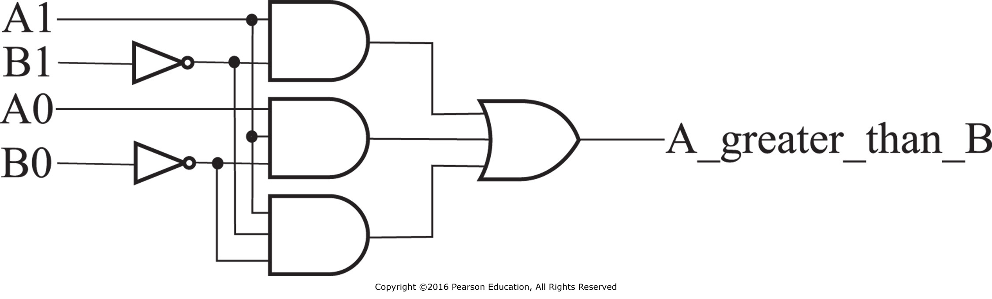
Modeling methods: An Example
Gate level schematic for a two-bit greater-than comparator circuit
Notes:
Can be derived from k-map

Slide 29
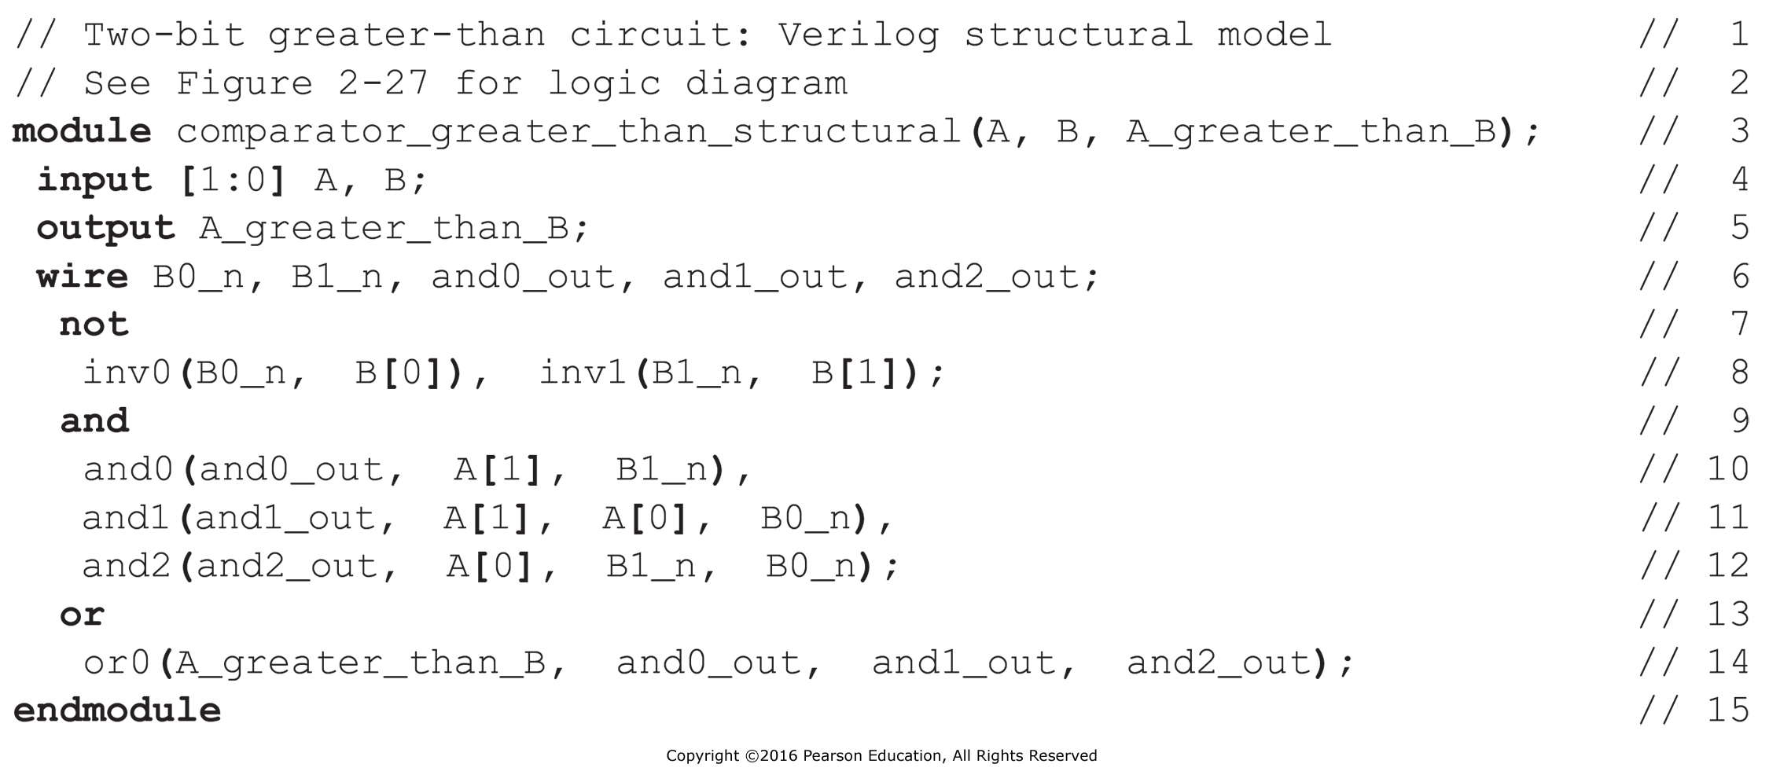
Modeling methods: An Example (cont’d)
Structural Verilog Description of Two-Bit Greater-Than Circuit

Slide 30
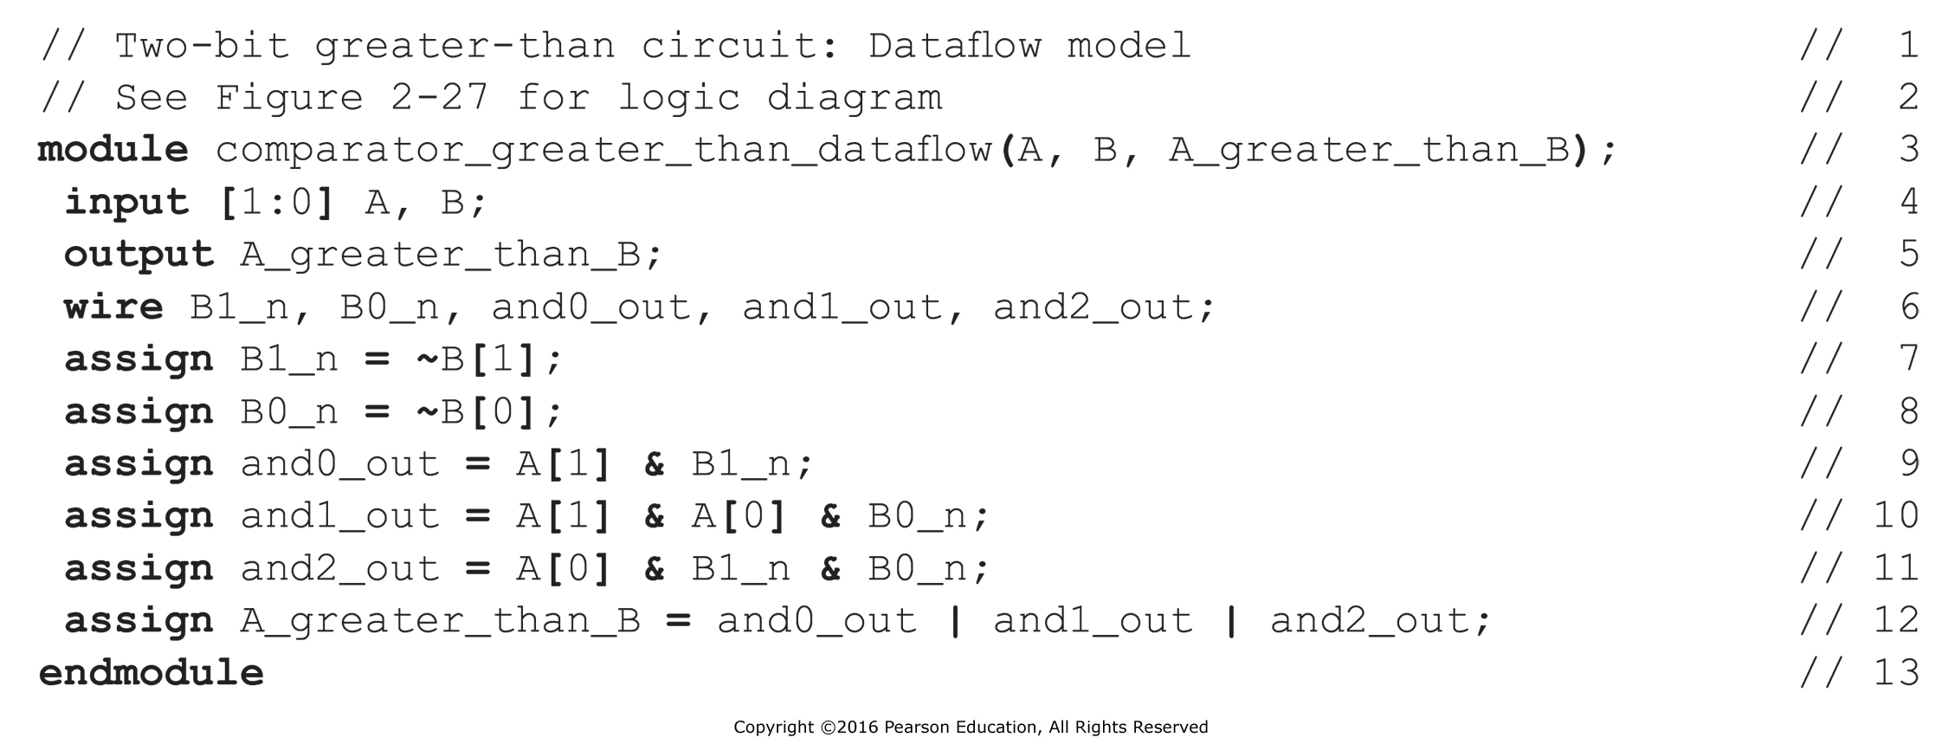
Modeling methods: An Example (cont’d)
Dataflow Verilog Description of Two-Bit Greater-Than Comparator
Notes:
数据流描述根据功能而非结构来描述电路，由并行赋值语句或与之等价的语句构成。只要语句右边的一个值改变，并行赋值语句即并行地执行。

Slide 31
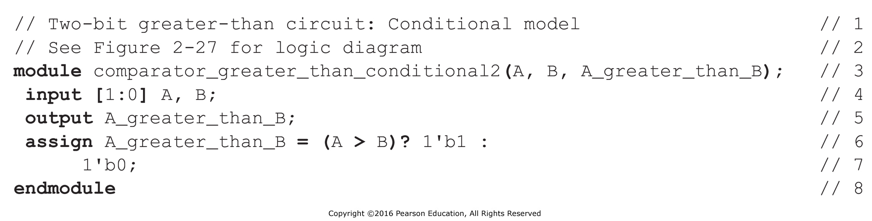
Modeling methods: An Example (cont’d)
Conditional Dataflow Verilog Description of Two-Bit Greater-Than Circuit

Slide 32
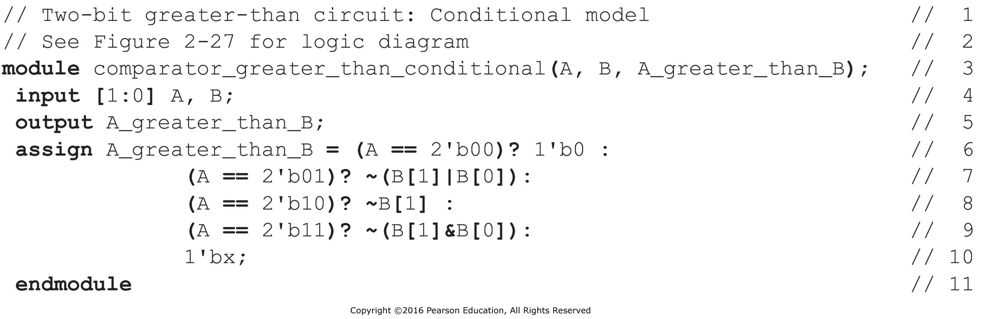
Modeling methods: An Example (cont’d)
Conditional Dataflow Verilog Description of Two-Bit Greater-Than Circuit Using Combinations

Slide 33
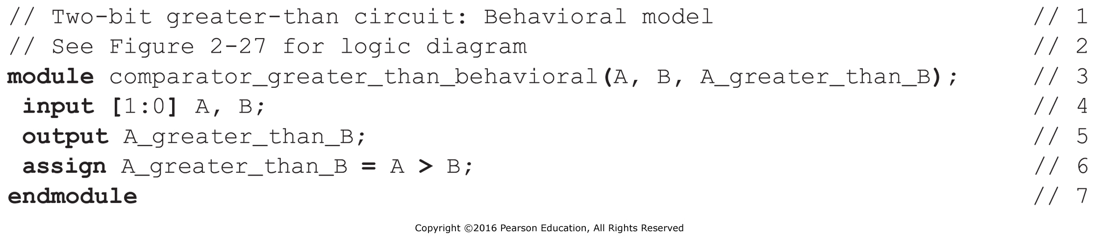
Modeling methods: An Example (cont’d)
Behavioral Verilog Description of Two-Bit Greater-Than Circuit

Slide 34
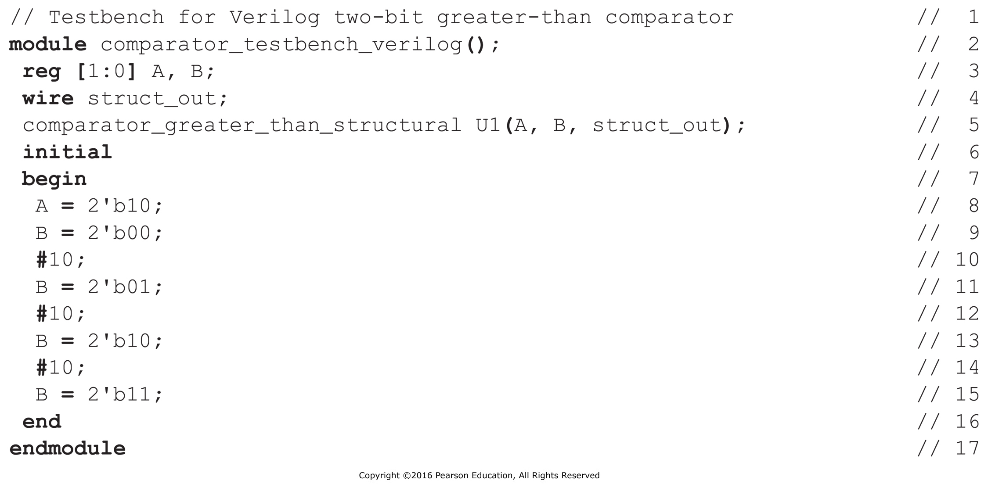
Modeling methods: An Example (cont’d)
Testbench for the Structural Model of the Two-Bit Greater-Than Comparator

Slide 35
Overview
Introduction to Verilog HDL
About combinational logic circuits
Some classic/basic designs
Timing analysis

Slide 36
Digital Logic Circuit
A “blackbox” with input(s) and output(s)
  Input: 0/1
  Output: 0/1
A collection of interconnected digital components
  Circuit elements
  Nodes
    Input, internal and output
Two types
  Combinational logic circuit
  Sequential logic circuit
Notes:
数字逻辑电路可被视为带有若干输入端和输出端的黑盒。
若干元件和结点互连而成，元件本身又可以是一个数字逻辑电路，结点可以是输入结点、内部结点和输出结点三种。
结点实际上是若干连线的汇集点，汇集于同一结点的所有连线上传输的是同一个信号。

Slide 37
Combinational Logic Circuit
A combinational logic circuit has:
  A set of m Boolean inputs,
  A set of n Boolean outputs, and
  n switching functions, each mapping the 2^{m} input combinations to an output such that the current output depends only on the current input values
A block diagram:
Combinational
Circuit
m-inputs
•
n-outputs
•
•
•
•
•
Notes:
A combinational circuit consists of logic gates whose outputs, at any time, are determined by combining the values of the inputs.
For n input variables, there are 2^{n} possible binary input combinations.
For each binary combination of the input variables, there is one possible output.

Slide 38
Combinational vs. Sequential Circuits
Combinational circuits are memory-less
  The output value depends ONLY on the current input values.
Sequential circuits consist of combinational logic as well as memory elements (used to store certain circuit states)
  Outputs depend on BOTH current input values and previous input values (kept in the storage elements).

Slide 39
Combinational vs. Sequential Circuits
n-inputs
Combinational
Circuit
m-outputs
(Depend only on inputs)
Combinational Circuit
n-inputs
m-outputs
Combinational
Circuit
Storage
Elements
Next
state
Sequential Circuit
Notes:
门电路实现的是1位运算，如果是n位的逻辑值运算，只需重复使用n个相同的门电路即可。
无需画出所有的，只需在输入端和输出端标注位数即可。
n位表示方法，textbook page #59

Slide 40
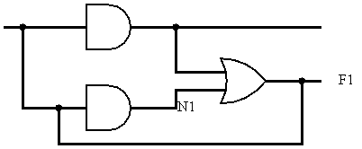
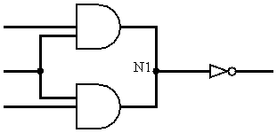
Characteristics of Combinational Logic Circuits
Each element is a combinational logic circuit.
A node can only be the output of one element.
Loop is not allowed.
Notes:
任何一个逻辑表达式都可以写成与、或、非三种基本的逻辑组合，因此任何一个组合逻辑电路都可以用与门、或门和非门的组合来描述。
最简单的组合逻辑电路是逻辑门电路。组合逻辑电路的构成规则规定了如何由门电路和简单组合电路构成更复杂的组合逻辑电路：
每个元件本身是组合逻辑电路；
不存在同一个结点同时是两个元件的输出结点；
不存在回路。

Slide 41
Design Choice Of Combinational Circuits
2-level vs. multi-level
  Gate delay
  Fan-in/fan-out
  Trade-off between cost and speed
Functional blocks
Notes:
每个逻辑表达式都可转换为规范/标准型，因此任何逻辑电路都可以是一个两级电路。
从逻辑门的输入信号改变开始，到输出信号发生改变所用的时间。两级电路延迟短，运算速度快。
两级电路所需硬件数量成倍增长，有时不可实现。
如F = A xor B xor C = A’B’C + ‘ABC’ + AB’C’ + ABC，两级电路需要4个3输入端与门和4个输入端或门，而多级电路只需串联两个异或门。
如果是8输入端异或门，两及电路要求128个8输入端与门和一个128输入端或门，无法实现；多级电路只需串联7个2输入端异或门。

Slide 42
Design Procedure
Specification
  Write a specification for the circuit if one is not already available (text, HDL)
Formulation
  Derive a truth table or initial Boolean equations that define the required relationships between the inputs and outputs, if not in the specification
Optimization
  Apply 2-level and multiple-level optimization
  Draw a logic diagram or provide a netlist for the resulting circuit using ANDs, ORs, and inverters
Notes:
Specification: 逻辑抽象，分析事件的因果关系，确定输入输出，逻辑赋值
Formulation: 根据因果关系写出真值表，函数式

Slide 43
Design Procedure
Technology Mapping
  Map the logic diagram or netlist to the implementation technology selected
Verification
  Verify the correctness of the final design

Slide 44
Optimum function
Logic Circuit
Optimization
Logic abstraction
Problem
Truth Table
assignment
Logic Circuit
Transferred function
Transformation

Slide 45
Design Example 1
Example: The only light in the room is controlled by three switches, and each switch can control the light separately. Please design the logic circuit for the light and switches with least gates.
Solutions: 1. Specification
Analysis result:
input signal: switches S₁,S₂,S₃
output signal: light F
“1” for switch closed and “0” for opened
“1” for light on and “0” for light off
Truth table
S₃ | S₂ | S₁ | F
0 | 0 | 0 | 0
0 | 0 | 1 | 1
0 | 1 | 0 | 1
0 | 1 | 1 | 0
1 | 0 | 0 | 1
1 | 0 | 1 | 0
1 | 1 | 0 | 0
1 | 1 | 1 | 1
2. Formulation

Slide 46
S₃ | S₂ | S₁ | F
0 | 0 | 0 | 0
0 | 0 | 1 | 1
0 | 1 | 0 | 1
0 | 1 | 1 | 0
1 | 0 | 0 | 1
1 | 0 | 1 | 0
1 | 1 | 0 | 0
1 | 1 | 1 | 1
3. Optimization
S₂ S₁
S₃
00 01 11 10
01
1
1
1
1
Already optimized
真值表：
Notes:
奇函数，三变量异或

Slide 47
4. Technology Mapping
Least use of gates?

Slide 48
Verilog Programming
module lamp_control(s1,s2,s3,F );
input s1,s2,s3;
output F;
wire s1,s2,s3,f;
assign F= (~s3&~s2&s1) | (~s3&s2&~s1) | (s3&~s2&~s1) | (s3&s2&s1) ;
endmodule
Notes:
Wire: 线网型变量,直通型的，相当于一根导线，只能用 Assign 赋值，输入一有变化，输出立刻体现。
Reg: 寄存器型变量，一定要有触发，输出才会有变化，只能在initial 和always中赋值。

Slide 49
Design Example 2
Specification
  BCD to Excess-3 code converter
  Transforms BCD code for the decimal digits to Excess-3 code for the decimal digits
  BCD code words for digits 0 through 9: 4-bit patterns 0000 to 1001, respectively
  Excess-3 code words for digits 0 through 9: 4-bit patterns consisting of 3 (binary 0011) added to each BCD code word
  Implementation:
    multiple-level circuit
    NAND gates (including inverters)

Slide 50
Design Example 2 (continued)
Formulation
  Conversion of 4-bit codes can be most easily formulated by a truth table
  Variables
  - BCD:
  A,B,C,D
  Variables
  - Excess-3
  W,X,Y,Z
  Don’t Cares
  - BCD 1010
  to 1111
Notes:
四个函数，每个函数四个自变量

Slide 51
Design Example 2 (continued)
C
C
Optimization
  2-level using
  K-maps
z
y
1
1
1
1
0
1
3
2
0
1
3
2
1
1
1
1
4
5
7
6
B
4
5
7
6
B
X
X
X
X
X
X
X
X
A
12
13
15
14
A
12
13
15
14
1
X
X
1
X
X
8
9
11
10
8
9
11
10
D
D
x
C
w
C
1
1
1
0
1
3
2
0
1
3
2
1
1
1
1
4
5
7
6
B
4
5
7
6
B
X
X
X
X
X
X
X
X
A
12
13
15
14
A
12
13
15
14
1
X
X
1
1
X
X
8
9
11
10
8
9
11
10
D
D

Slide 52
Design Example 2 (continued)
Optimization (continued)
  Multiple-level using transformations
  Perform extraction, finding factor: T₁ = C + D
G = 7 + 10+ 6 + 0 = 23
G = 2+4+7+6+0=19
Notes:
多级优化：提公因子
三级电路

Slide 53
Design Example 2 (continued)
  Multiple-level using transformations
  An additional extraction not shown in the text since it uses a Boolean transformation:
G = 2+4+7+6+0=19
G = 2 +1 + 4 + 6 + 4 + 0 = 17!
Notes:
1是T1’的成本，自变量的非门因为有时候可以由前面电路产生，可以不算。但是T1的非门要算
三级电路变成四级电路，T1的非算一级

Slide 54
Design Example 2 (continued)
Technology Mapping
  Mapping with a library containing inverters and 2-input NAND, 3-input NAND, 2-input NOR, and 2-2 AOI gates
A
W
B
X
T₁
C
Y
D
Z

Slide 55
Verilog Programming
module BCD_ Excess_3( A,B,C,D,W,X,Y,Z );
input A,B,C,D;
output W,X,Y,Z;
wire A,B,C,D , W,X,Y,Z,T1;
assign T1 = C|D;
assign W = A|B&C|B&D ;
assign X = ~B&T1|B&~T1;
assign Y = C&D|~T1;
assign Z= ~D ;
endmodule

Slide 56
Overview
Introduction to Verilog HDL
About combinational logic circuits
Some classic/basic designs
Timing analysis

Slide 57
Some Classic/Basic Designs
Functions and functional blocks
Rudimentary logic functions
Encoder and decoder
Multiplexer and demultiplexer
Half adder and full adder

Slide 58
Functions and Functional Blocks
The functions considered are those found to be very useful in design
Corresponding to each function is a combinational circuit implementation called a functional block.
In the past, many functional blocks were implemented as SSI, MSI, and LSI circuits.
Today, they are often used as simply parts within a VLSI circuit.

Slide 59
Rudimentary Logic Functions
Four elementary combinational logic functions
  Value-Fixing: F = 0 or F = 1 , no Boolean operator
  Transferring: F = X , no Boolean operator
  Inverting: F = X , involves one logic gate
  Enabling: F = X·EN or F = X + EN , involves one or two logic gates
  The first three are functions of a single variable X
Table 4-1
Functions of one variable
V
CC
or V
DD
1
F
=
1
F
=
1
X
F
=
X
X
F
=0
F
=X
F
=
X
F=1
(c)
0
0
0
1
1
0
F
=
0
F
=
0
X
F
=
X
1
0
1
0
1
(a)
(b)
(d)

Slide 60
Multiple-bit Rudimentary Functions
Multi-bit Examples:
A wide line is used to represent
a bus which is a vector signal
In (b) of the example, F = (F₃, F₂, F₁, F₀) is a bus.
The bus can be split into individual bits as shown in (b)
Sets of bits can be split from the bus as shown in (c)
for bits 2 and 1 of F.
The sets of bits need not be continuous as shown in (d) for bits 3, 1, and 0 of F.
A
F
A
3
3
2
1
F
1
2
4
4
2:1
F(2:1)
2
F
0
F
0
F
1
1
A
0
(c)
F
0
A
(a)
(b)
3
4
3,1:0
F(3), F(1:0)
F
(d)
Notes:
比如说rom, 输出8位, 一把抓

Slide 61
Enabling Function
Enabling permits an input signal to pass through to an output
Disabling blocks an input signal from passing through to an output, replacing it with a fixed value
The value on the output when it is disable can be Hi-Z (as for three-state buffers and transmission gates), 0 , or 1
When disabled, 0 output
When disabled, 1 output
See Enabling App in text
X
F
EN
(a)
X
F
EN
(b)
Notes:
使能: 三态门 (禁止时输出是高阻), 与门(禁止时输出是0), 或门(禁止时是1)

Slide 62
Decoding
Decoding - the conversion of an n-bit input code to an m-bit output code with
n ≤ m ≤ 2^{n} such that each valid code word produces a unique output code
Circuits that perform decoding are called decoders
Here, functional blocks for decoding are
  called n-to-m line decoders, where m ≤ 2^{n}, and
  generate 2^{n} (or fewer) minterms for the n input variables

Slide 63
Classic Designs: Decoder
Multiple inputs: address, binary code, ...
Multiple outputs: one-hot, ...
Example:
  3-bit binary input, 8-bit output.
  When the input 3 bits are 000, then the first bit in output is 1, and others are 0.
  When the input 3 bits are 001, then only the second bit in output is 1.
  ...
Notes:
保证每一个有效的输入码都产生唯一的输出码。
多输入端、多输出端电路，输入端少于输出端
输入端一般是一种二进制编码（地址码、指令码等），输出端通常为单热点编码。
Decoding - the conversion of an n-bit input code to an m-bit output code with
n <= m <= 2^{n} such that each valid code word produces a unique output code
Circuits that perform decoding are called decoders
Here, functional blocks for decoding are
called n-to-m line decoders, where m <= 2^{n}, and
generate 2^{n} (or fewer) minterms for the n input variables

Slide 64
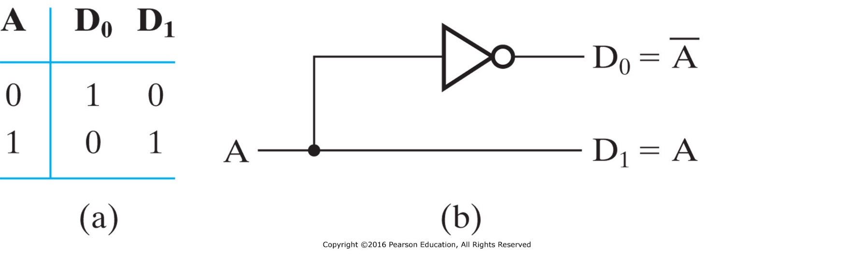
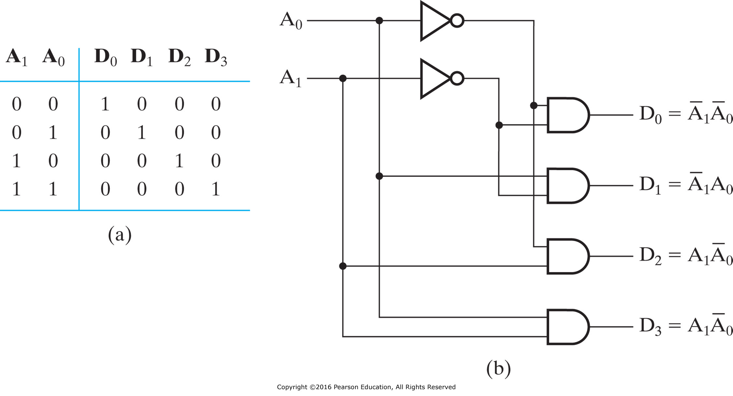
Decoder Examples
1-to-2-Line Decoder
2-to-4-Line Decoder
The 2-4-line made up of 2 1-to-2-line decoders and 4 (2-inputs) AND gates.

Slide 65
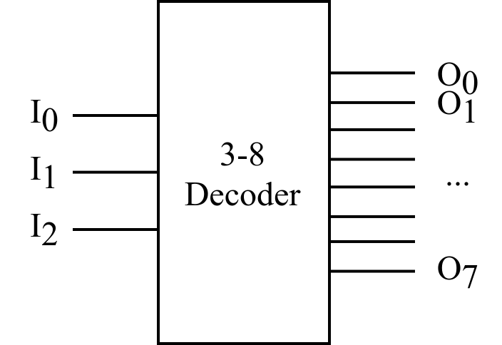
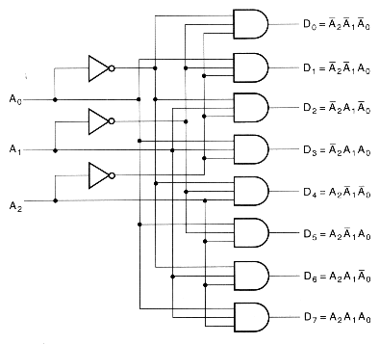
Decoder Examples (cont’d)
Input |  |  | Output
A₂ | A₁ | A₀ | D₀ | D₁ | D₂ | D₃ | D₄ | D₅ | D₆ | D₇
0 | 0 | 0 | 1 | 0 | 0 | 0 | 0 | 0 | 0 | 0
0 | 0 | 1 | 0 | 1 | 0 | 0 | 0 | 0 | 0 | 0
0 | 1 | 0 | 0 | 0 | 1 | 0 | 0 | 0 | 0 | 0
0 | 1 | 1 | 0 | 0 | 0 | 1 | 0 | 0 | 0 | 0
1 | 0 | 0 | 0 | 0 | 0 | 0 | 1 | 0 | 0 | 0
1 | 0 | 1 | 0 | 0 | 0 | 0 | 0 | 1 | 0 | 0
1 | 1 | 0 | 0 | 0 | 0 | 0 | 0 | 0 | 1 | 0
1 | 1 | 1 | 0 | 0 | 0 | 0 | 0 | 0 | 0 | 1
The 3-8-line is made up of 3 1-to-2-line decoders and 8 (3-inputs) AND gates.
Notes:
Gate input cost: 3 + 3 * 8 = 27

Slide 66
Decoder Expansion
General procedure for any decoder with n inputs and 2^{n} outputs
  Step 1: let k = n
  Step 2: there are 2^{k} AND gates which will be driven by 2 decoders
    If k is even, both decoders have 2^{k/2} outputs.
    If k is odd, one decoder has 2^{(k+1)/2} outputs, while another one has 2^{(k-1)/2} outputs.
  Step 3: for each decoder obtained from step 2, let the number of outputs becomes k, and repeat step 2 until k=1 (i.e., 1-to-2-line decoder).
The output AND gates are driven by two decoders with their numbers of inputs either equal or differing by 1.
These decoders are then designed using the same procedure until 1-to-2-line decoders are reached.
The procedure can be modified to apply to decoders with the number of outputs ≠ 2^{n}.
Notes:
分层设计降低门输入成本。
This procedure builds a decoder backward from the outputs.

Slide 67
Decoder Expansion: 3-8 Decoder
Number of output ANDs = 8
Number of inputs to decoders driving output ANDs = 3
Closest possible split to equal
  2-to-4-line decoder
  1-to-2-line decoder
2-to-4-line decoder
  Number of output ANDs = 4
  Number of inputs to decoders driving output ANDs = 2
  Closest possible split to equal
    Two 1-to-2-line decoders

Slide 68
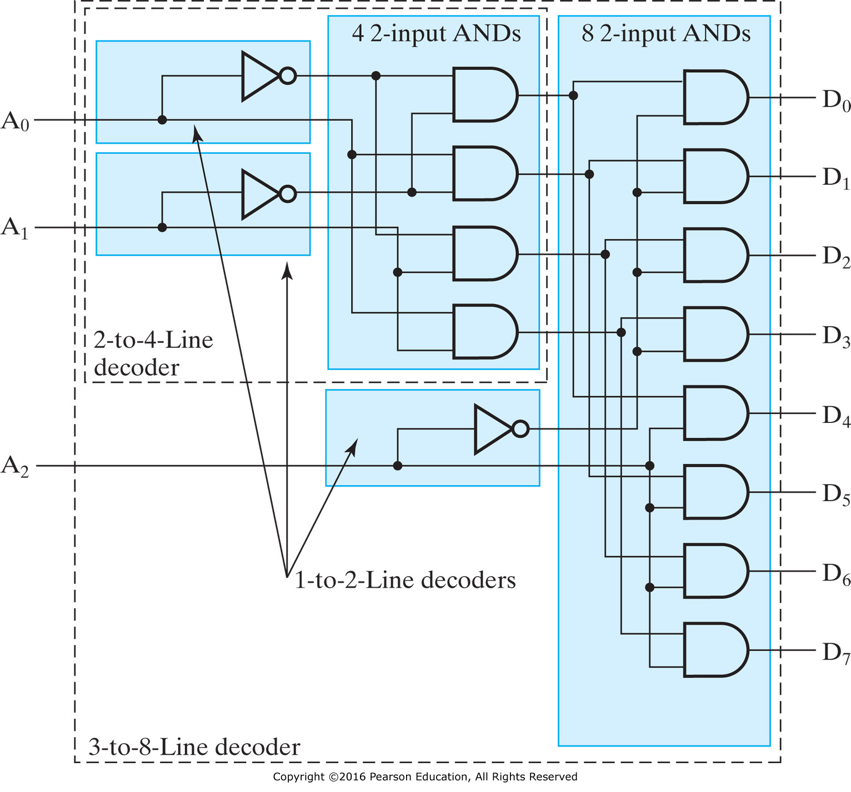
Decoder Expansion: 3-8 Decoder (cont’d)
Notes:
Gate input cost：3 + 2 * 4 + 2 * 8 = 27
How about 6-64 decoder?
6 + 6 * 64 = 390 vs. 6 + 2 * (2 * 4) + 2 * (2 * 8) + 2 * 64 = 182

Slide 69
Decoder with Enable
In general, attach m-enabling circuits to the outputs
See truth table below for function
  Note use of X’s to denote both 0 and 1
  Combination containing two X’s represent four binary combinations
Alternatively, can be viewed as distributing value of signal EN to 1 of 4 outputs
In this case, called a
demultiplexer
Notes:
可视为多路分配器，把EN的值分配到output

Slide 70
Combinational Logic Implementation
- Decoder and OR Gates
Implement m functions of n variables with:
  Sum-of-minterms expressions
  One n-to-2^{n}-line decoder
  m OR gates, one for each output
Approach 1:
  Find the truth table for the functions
  Make a connection to the corresponding OR from the corresponding decoder output wherever a 1 appears in the truth table
Approach 2
  Find the minterms for each output function
  OR the minterms together
Notes:
基于译码器的组合电路
n个输入变量的译码器可以产生2^n个最小项，由于任何Boolean function都可以由SoP表示，任何n输入m输出的组合电路都可以用1个n-2^n译码器和m个或门实现。

Slide 71
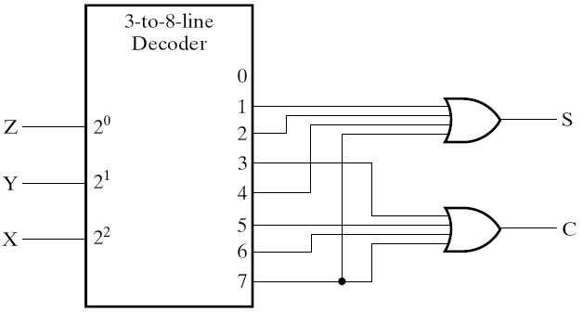
Decoder and OR Gates Example
Implement a binary Adder
Finding sum of
minterms expressions
S(X, Y, Z) = Σ_{m}(1, 2, 4, 7)
C(X, Y, Z) = Σ_{m}(3, 5, 6, 7)
Find circuit
Truth Table
Notes:
1位的二进制加法：X + Y，Z是来自低位的进位输入
输出S，进位输出位C

Slide 72
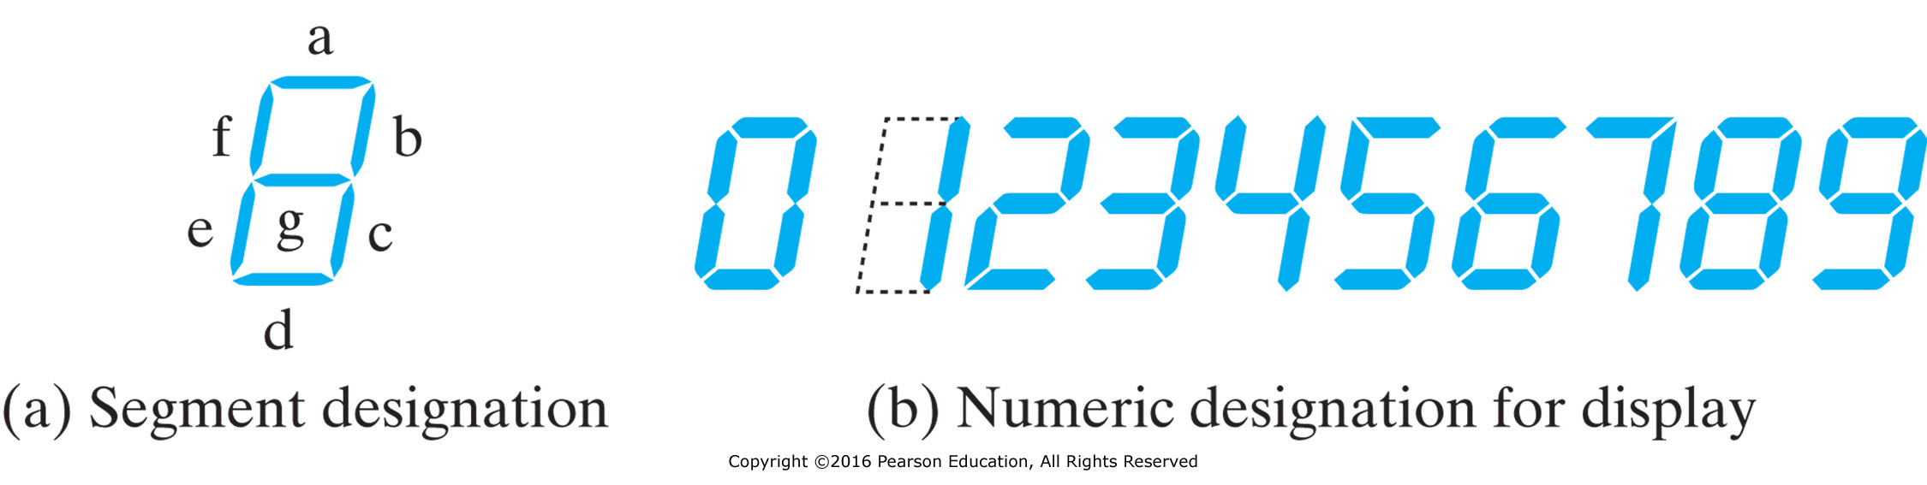
Seven-Segment Display Decoder
Input |  |  |  | Output
I₀ | I₁ | I₂ | I₃ | O_{a} | O_{b} | O_{c} | O_{d} | O_{e} | O_{f} | O_{g}
0 | 0 | 0 | 0 | 1 | 1 | 1 | 1 | 1 | 1 | 0
0 | 0 | 0 | 1 | 0 | 1 | 1 | 0 | 0 | 0 | 0
0 | 0 | 1 | 0 | 1 | 1 | 0 | 1 | 1 | 0 | 1
0 | 0 | 1 | 1 | 1 | 1 | 1 | 1 | 0 | 0 | 1
0 | 1 | 0 | 0 | 0 | 1 | 1 | 0 | 0 | 1 | 1
0 | 1 | 0 | 1 | 1 | 0 | 1 | 1 | 0 | 1 | 1
0 | 1 | 1 | 0 | 1 | 0 | 1 | 1 | 1 | 1 | 1
0 | 1 | 1 | 1 | 1 | 1 | 1 | 0 | 0 | 0 | 0
1 | 0 | 0 | 0 | 1 | 1 | 1 | 1 | 1 | 1 | 1
1 | 0 | 0 | 1 | 1 | 1 | 1 | 1 | 0 | 1 | 1
Seven-segment display decoder
Oa
I0
Ob
I1
Oc
Od
I2
Oe
I3
Of
Og
Notes:
4-16译码器+7个或门

Slide 73
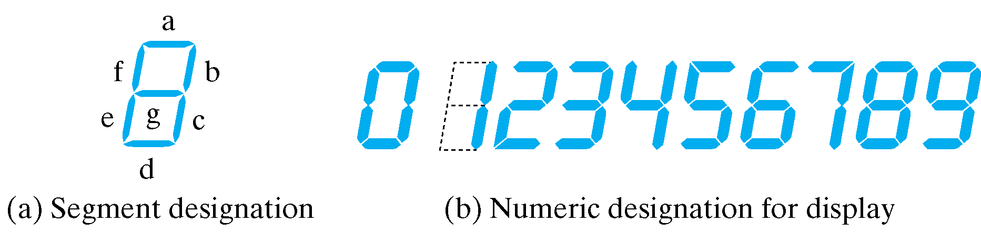
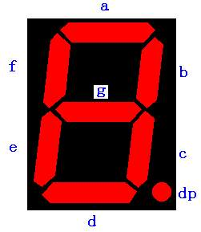
BCD-to-Segment Decoder
Seven-Segment Displayer

Slide 74
Seven Segment Displayer
VCC=5V
Common electrode
d
c
b
a
a
R
Common Anode
“0”
GND
e
f
g
h
a
Common electrode
Common Cathode
R
“1”
Notes:
二极管分为阳极,阴极, 阳极到阴极有一个导通的电流就会亮.

Slide 75
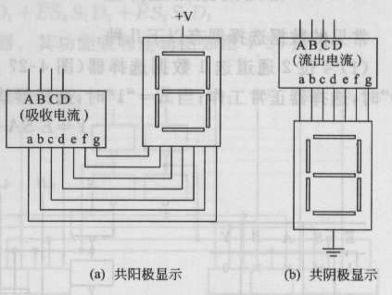
The Common Anode Display (CAD)
  All the anode connections of the LED's are joined together to logic "1" and the individual segments are illuminated by connecting the individual Cathode terminals to a "LOW", logic "0" signal.
  a~g = 0 on, a~g = 1 off (Active Low)
The Common Cathode Display (CCD)
  All the cathode connections of the LED's are joined together to logic "0" or ground.
  The individual segments are illuminated by application of a "HIGH", logic "1" signal to the individual Anode terminals.
  a~g = 1 on, a~g = 0 off (Active High)
Notes:
实验板子上4个数码管显示器, 如果要他们全部都亮, 一共需要8*4=32, 实际应用中利用视觉暂留, 只用12个脚(4个公共控制脚+8个显示脚). 视觉暂留大概0.05-0.2秒, 很高的频率(几khz), 看起来输出是连续的.

Slide 76
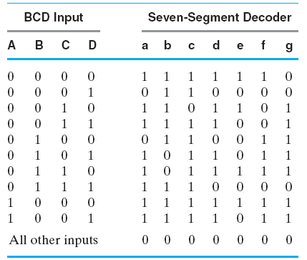
BCD-to-Seven Segment Decoder
Truth Table for BCD-to-Seven-Segment Decoder

Slide 77
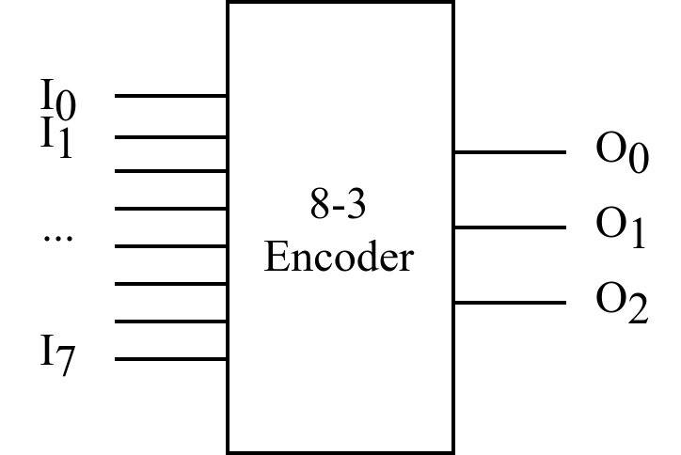
Classic Designs: Encoder
8-to-3-line encoder
Input |  |  |  |  |  |  |  | Output
I₀ | I₁ | I₂ | I₃ | I₄ | I₅ | I₆ | I₇ | O₀ | O₁ | O₂
1 | 0 | 0 | 0 | 0 | 0 | 0 | 0 | 0 | 0 | 0
0 | 1 | 0 | 0 | 0 | 0 | 0 | 0 | 0 | 0 | 1
0 | 0 | 1 | 0 | 0 | 0 | 0 | 0 | 0 | 1 | 0
0 | 0 | 0 | 1 | 0 | 0 | 0 | 0 | 0 | 1 | 1
0 | 0 | 0 | 0 | 1 | 0 | 0 | 0 | 1 | 0 | 0
0 | 0 | 0 | 0 | 0 | 1 | 0 | 0 | 1 | 0 | 1
0 | 0 | 0 | 0 | 0 | 0 | 1 | 0 | 1 | 1 | 0
0 | 0 | 0 | 0 | 0 | 0 | 0 | 1 | 1 | 1 | 1
$$O0=I4+I5+I6+I7$$
$$O1=I2+I3+I6+I7$$
$$O2=I1+I3+I5+I7$$
OR gates!
However, there exists two issues that may make the encoder just designed does not work:
  1. If more than one input value is 1 (e.g., I3 & I6 are both 1)
  2. All inputs are 0 vs. I0 = 1

Slide 78
Priority Encoder Example
Priority encoder with 4 inputs (D₃, D₂, D₁, D₀) - highest priority to most significant 1 present - Code outputs A1, A0 and V where V indicates at least one 1 present.
Xs in input part of table represent 0 or 1; thus table entries correspond to product terms instead of minterms. The column on the left shows that all 16 minterms are present in the product terms in the table
No. of Min-terms/Row | Inputs |  |  |  | Outputs
 | D3 | D2 | D1 | D0 | A1 | A0 | V
1 | 0 | 0 | 0 | 0 | X | X | 0
1 | 0 | 0 | 0 | 1 | 0 | 0 | 1
2 | 0 | 0 | 1 | X | 0 | 1 | 1
4 | 0 | 1 | X | X | 1 | 0 | 1
8 | 1 | X | X | X | 1 | 1 | 1
Notes:
优先权编码器，紧凑真值表

Slide 79
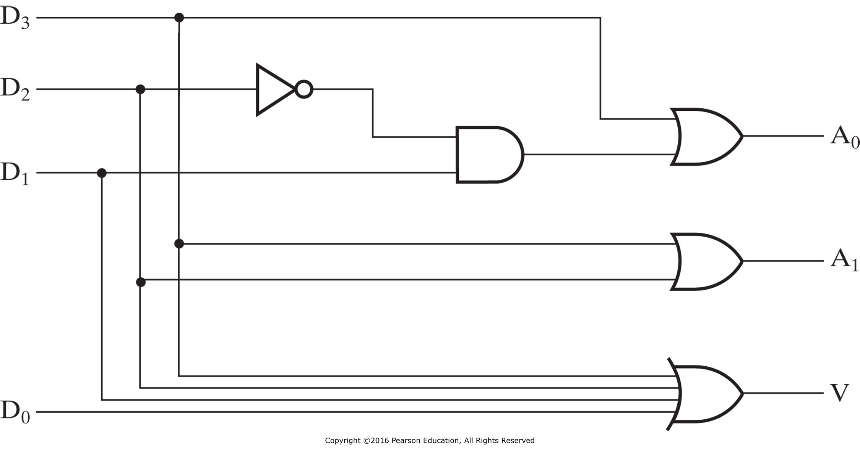
Priority Encoder Example (cont’d)
Could use a K-map to get equations, but can be read directly from table and manually optimized if careful:
  $A1= ?$
  $A0= ?$
  $V= ?$
Notes:
A1=D3 + D2
A0=D3+(D2)’D1
V = D3 + D2 + D1 + D0

Slide 80
Classic Designs: Multiplexer
Selecting of data or information is a critical function in digital systems and computers
Circuits that perform selecting have:
  A set of information inputs from which the selection is made
  A single output
  A set of control lines for making the selection
Logic circuits that perform selecting are called multiplexers
Selecting can also be done by three-state logic or transmission gates
Notes:
Multiplexer (MUX, mux)
Decoder with enable

Slide 81
Multiplexers
A multiplexer selects information from an input line and directs the information to an output line
A typical multiplexer has n control inputs (S_{n − 1}, … S₀) called selection inputs, 2^{n} information inputs (I₂^{n} ₋ ₁, … I₀), and one output Y
A multiplexer can be designed to have m information inputs with m < 2^{n} as well as n selection inputs
MUX
DBUS
m
Y
n
CBUS
Notes:
多路选择器，也称复用器或数据选择器，功能是从多个可能的输入中选择一个直接输出，包括输入端和控制端S。
K路选择器，S位数应该是log₂k向上取整。
比如对于3路或者4路选择器，S有2位；对于5~8路选择器，S有3位。

Slide 82
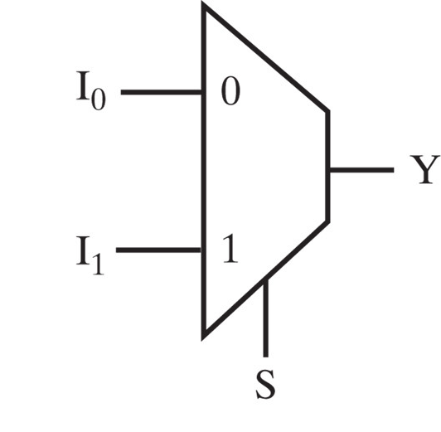
2-to-1-Line Multiplexer
Since 2 = 2¹, n = 1
The single selection variable S has two values:
  S = 0 selects input I₀
  S = 1 selects input I₁
The equation:
Y = I₀ + SI₁
The circuit:
S

Slide 83
2-to-1-Line Multiplexer (cont’d)
Note the regions of the multiplexer circuit shown:
  1-to-2-line Decoder
  2 Enabling circuits
  2-input OR gate
To obtain a basis for multiplexer expansion, we combine the Enabling circuits and OR gate into a 2 × 2 AND-OR circuit:
  1-to-2-line Decoder
  2 ⋅ 2 AND-OR
In general, for an 2^{n}-to-1-line multiplexer:
  n-to-2^{n}-line Decoder
  2^{n} ⋅ 2 AND-OR

Slide 84
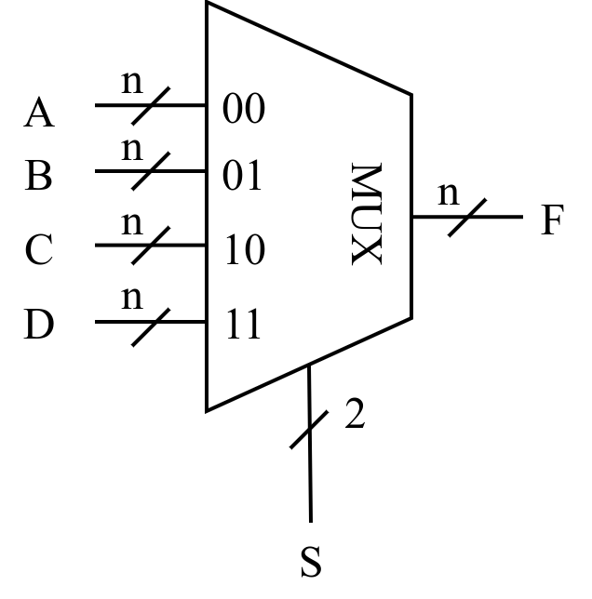
4-to-1-line Multiplexer
Input |  | Output
S₀ | S₁ | F
0 | 0 | A
0 | 1 | B
1 | 0 | C
1 | 1 | D
Notes:
F = S₁’S₀’A + S₁’S₀B + S₁S₀’C + S₁S₀D
Cost: 12 + 4 + 2 = 18

Slide 85
4-to-1-line Multiplexer (cont’d)
2-to-2²-line decoder
2² × 2 AND-OR
S
Decoder
1
S
4
×
2 AND-OR
0
Decoder
S
Decoder
S
1
1
S
S
0
I
0
0
Y
I
1
Y
Y
I
2
I
3
Notes:
F = (S₁’S₀’)A + (S₁’S₀)B + (S₁S₀’)C + (S₁S₀)D
Cost: 4 + 2 * 8 + 2 = 22

Slide 86
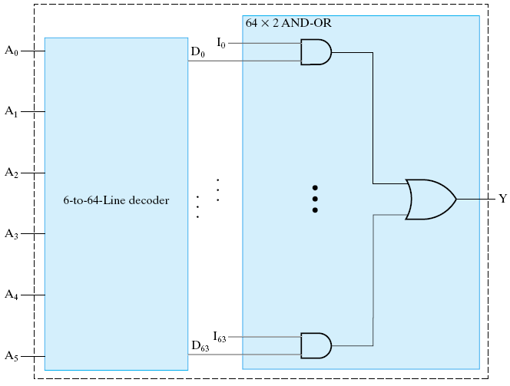
Example: 64-to-1-line Multiplexer
6-to-2⁶-line decoder
2⁶ ⋅ 2 AND-OR

Slide 87
Multiplexer Width Expansion
Select “vectors of bits” instead of “bit”
Use multiple copies of 2^{n} ⋅ 2 AND-OR in parallel
Example:
4-to-1-line
quad multi-
plexer
Notes:
计算机里面需要选择的不是位, 而是向量, 比如两个32位值, 选择一个填到某个结构(内存)
前面的只能选择一位, 输出也是一位.

Slide 88
Other Selection Implementations
Three-state logic in place of AND-OR
Gate input cost = 18
S
1
S
0
I
0
I
1
Y
I
2
I
3
Notes:
三态门可以把多个输出连在一起, 条件是任何时刻只能有一个三态门输出有效值, 其他的都是高阻. 这个和前面的译码器一样, 所以可以把译码器的输出分别连到三态门的控制脚, 构成选择器
用与或门,成本是22 (算上非门), 用三态门是18, 一个三态门成本是2,
还可以进一步优化，

Slide 89
Other Selection Implementations
Distributing the decoding across the three-state drivers
Gate input cost = 14
GN of AND-OR gate implementation:22
GN of implementation with AND-OR gate replaced by three-state drivers: 18
Notes:
分两次选，第一次选奇偶性，S0; 第二次选稿地位，S1

Slide 90
Other Selection Implementations
Transmission Gate Multiplexer
Gate input
cost = 8
compared
to 14 for
3-state logic
and 18 or 22
for gate logic
＝
＝
＝
＝
＝
＝
Notes:
传输门的成本和非门一样, 两个晶体管组成的, 成本是1.
计算机设计里面会大量地使用多路复用器, 所以一再地研究怎么样降低成本. 多路复用器的优化设计也是非常讲究的一个问题. 还有后面要讲到的加法器也是一样, 精益求精, 有很多工作, 论文关于怎么样降低加法器成本的.怎么把27个晶体管变成26个等等.

Slide 91
Combinational Logic Implementation
- Multiplexer Approach 1
Implement m functions of n variables with:
  Sum-of-minterms expressions
  An m-wide 2^{n}-to-1-line multiplexer
Design:
  Find the truth table for the functions.
  In the order they appear in the truth table:
    Apply the function input variables to the multiplexer inputs S_{n − 1}, … , S₀
    Label the outputs of the multiplexer with the output variables
  Value-fix the information inputs to the multiplexer using the values from the truth table (for don’t cares, apply either 0 or 1)

Slide 92
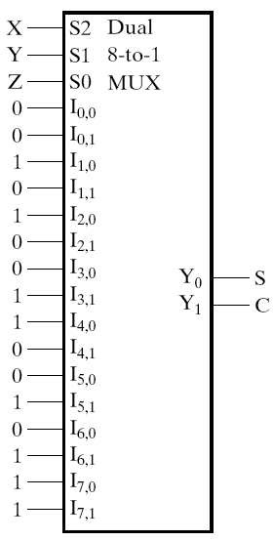
One Bit Binary Adder By Multiplexer
Implementing a 1-bit Binary Adder with a Dual 8-to-1-Line Multiplexer
  Truth table
  Circuit:
Notes:
三个输入,所以用8选1,2位输出,所以是两个8选1多路复用器, 用同一组控制
可不可以用4选1多路复用器? X和y相同的时候, 看c和z的关系

Slide 93
Overview
Introduction to Verilog HDL
About combinational logic circuits
Some classic/basic designs
Timing analysis

Slide 94
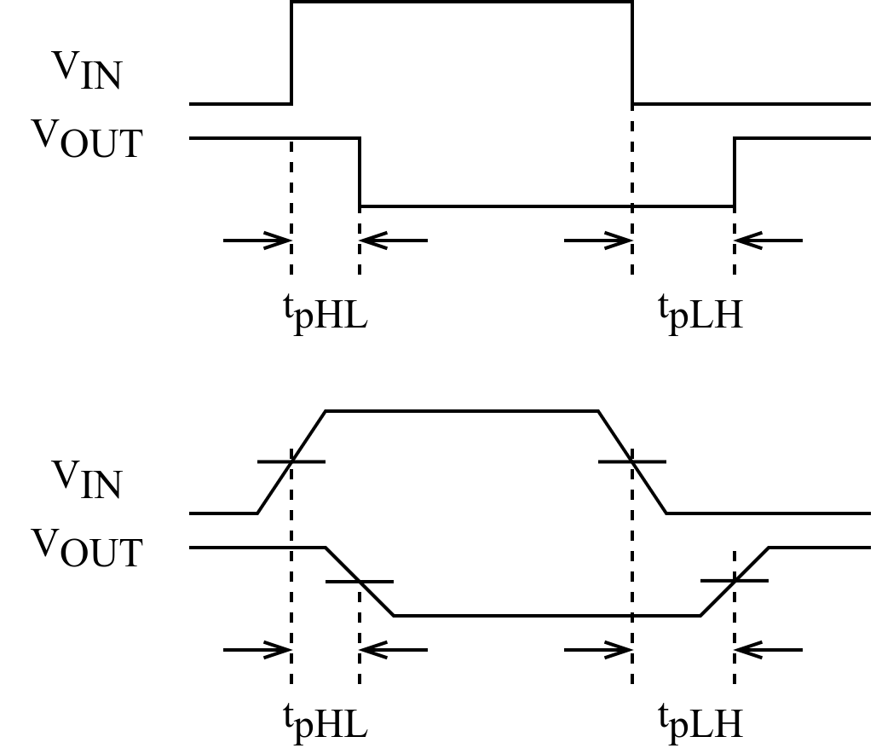
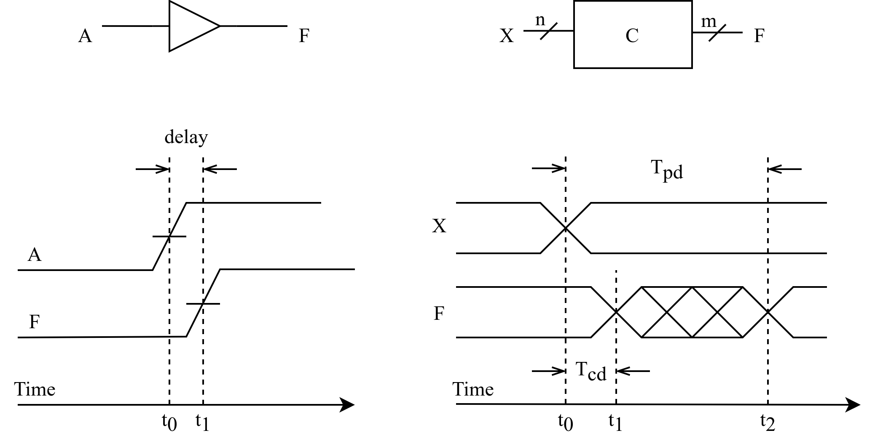
Timing Analysis
Circuit delay
Ideal case
In practice
Delay of the invertor
Rise-time delay of the transmission gate
Notes:
信号通过连线以及电路元件时，会有一定的延迟：连线的长短、元件的数量、电路制造工艺、工作电压、温度等；此外信号的高低电平转换也需要一定的过渡时间。
任何组合逻辑电路从输入信号的改变到随之引起的输出信号的改变中间都有一定的时间延迟。
理想情况：忽略上升时间和下降时间
为避免信号上升过程和下降过程时间不一致带来的影响，通常取信号转换的中点来测量电路的延迟时间。
缓冲器电路的时序图（上升沿电路延迟）：时间位t0和t1之间的间隔，分别是输入A和输出F两个信号的上升沿的中间点。

Slide 95
Timing Analysis (cont’d)
Propagation delay
  T_{pd} = max delay from input to output
Contamination delay
  T_{cd} = min delay from input to output
Reasons why T_{pd} and T_{cd} may be different:
  Different rising and falling delays
  Multiple inputs and outputs, some of which are faster than others
  Circuits slow down when hot and speed up when cold
Notes:
组合逻辑电路的时序特征包括：
1. Propagation delay: 传输延迟，从输入端的变化开始到所有输出端得到最终稳定的信号所需的最长时间
2. Contamination delay：最小延迟，从输入端变化开始到任何一个输出开始发生改变所需的最短时间
电路延迟可以通过计算信号从输入到输出所经过的路径上每个元件的延迟之和得到。

Slide 96
Timing Analysis (cont’d)
The critical (longest) path
  T_{pd} of the circuit = ∑ all T_{pd} of circuit elements along the critical path
The shortest path
  T_{cd} of the circuit = ∑ all T_{cd} of circuit elements along the shortest path
Tpd = 2Tpd_AND + Tpd_OR
Tcd = Tcd_AND
Notes:
1) 一个组合电路在输入和输出之间经过的最长路径称为关键路径，因此组合电路的传输延迟就是关键路径上所有元件的传输延迟之和；
2) 最小延迟就是最短路径上所有元件的最小延迟之和。

Slide 97
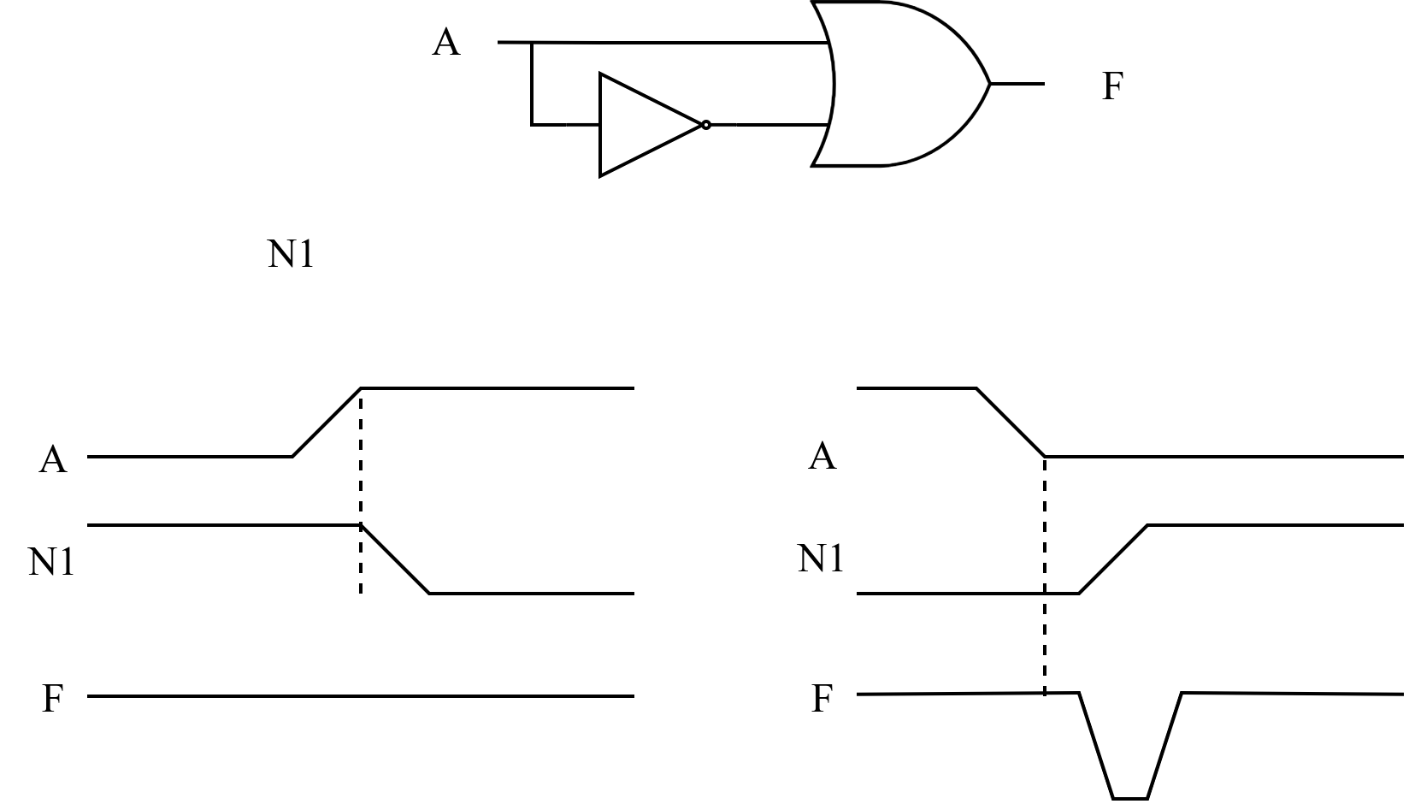
Timing Analysis (cont’d)
Race hazard
  Glitch: when a single input change causes multiple output changes
N1
Race hazard in a circuit
No glitch
Glitch
Notes:
如果存在某个输入信号经过两条或者两条以上的路径作用到输出端F，由于路径延迟不同，输入信号会对输出信号发生先后不同的影响，即竞争（race）。
由于竞争的存在，当多路输入信号的电平值发生变化时，在信号变化的瞬间，电路的输出信号可能会出现一些不正确的尖峰信号，即毛刺（glitch）。
如果要给组合逻辑电路中有毛刺出现，说明改电路存在冒险（hazard），或竞争冒险。
A从低电平变为高电平，N1随之从高变低，N1变为低电平之前，A已经变为高电平，所以F一直是高电平，无毛刺；反之则有毛刺。
如果输出信号最终将稳定在正确的电平上，毛刺通常不会导致问题，只要在获取电路输出值之前至少等待传输延迟的时间即可。

Slide 98
Analysis of Logic Circuits
Write the Boolean function for the circuit
  begin with the input signal
  Define the relationship of each gate
  optimization
Derive a truth table
  Define the relationships between the inputs and outputs,
Functional Analysis
  Define the function of each signal and the whole circuit
  Draw the timing diagram of the circuit
Verification
  Verify the correctness of the final design
Notes:
变量内涵：开关电路的开和关

Slide 99
Analyze the Function of the Logic Circuit
Logic Circuits
List the Boolean functions for all signals

Slide 100
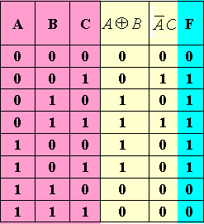
Boolean Function Simplification
Derive the truth table

Slide 101
Boolean Function Simplification
Derive the truth table
From the truth table, we can see that F=1 if A≠B or A<C.
The original design is not
the best. Use the following
circuits instead.
Notes:
功能分析比较难，需要灵光一现

Slide 102
Summary
Introduction to Verilog HDL
About combinational logic circuits
Some classic/basic designs
Timing analysis

